Slide 1
Numerical Precision Impact on AI Inference Across CPU, GPU, TPU and NPU
Computer Architecture — Individual Research Project
Presented by:
Kashaf sarfraz
24F-0583

Slide 2
Introduction and Background
Artificial Intelligence (AI) applications depend on high-performance computing hardware to process large amounts of data.
Modern AI models perform millions of mathematical operations during inference.
Matrix multiplication is a major operation in deep learning.
CPU, GPU, TPU and NPU architectures use different approaches to process AI workloads.
Numerical precision formats such as FP32, FP16 and BF16 affect performance, memory usage and accuracy.
Choosing suitable hardware and numerical precision can improve AI inference efficiency.

Slide 3
Problem Statement & Research Objectives
Problem Statement
AI inference performance varies across hardware architectures and numerical precision formats. However, the performance benefits and accuracy trade-offs of these choices are not always clear.
Research Objectives
Compare AI-related computing performance across CPU, GPU and TPU.
Study the impact of FP32, FP16 and BF16 numerical precision.
Evaluate matrix multiplication performance and memory bandwidth.
Analyze AI inference using CNN, Transformer and LSTM workloads.
Examine hardware performance using Roofline Model and Amdahl's Law.
Discuss the potential role of NPU architecture in AI inference.

Slide 4
Research Questions & Hypothesis
Research Questions
How does matrix multiplication performance differ across CPU, GPU and TPU?
How do FP32, FP16 and BF16 affect execution time and numerical accuracy?
How do memory bandwidth and data transfer overhead affect AI performance?
- How does hardware architecture influence CNN, Transformer and LSTM inference?
How can Roofline Model and Amdahl's Law explain hardware performance?
Research Hypothesis GPU and TPU architectures are expected to provide higher performance than CPU for computationally intensive AI workloads. Reduced-precision formats may improve execution speed on supported hardware, but can introduce numerical accuracy trade-offs.

Slide 5
Hardware Architecture Overview
CPU (Central Processing Unit)
Designed for general-purpose computing.
Handles sequential and diverse workloads.
GPU (Graphics Processing Unit)
Contains many processing cores.
Suitable for parallel computations and matrix operations.
TPU (Tensor Processing Unit)
Specialized accelerator designed for machine learning.
Optimized for tensor and matrix operations.
NPU (Neural Processing Unit)
Specialized hardware for neural network operations.
Designed to accelerate AI tasks efficiently.
Task 1
Task 2
Task 3

Slide 6
Experimental Setup & Methodology
Experimental Environment
Platform: Google Colab
Programming Framework: PyTorch
CPU: Intel Xeon @ 2.00 GHz
GPU: NVIDIA Tesla T4 (15 GB)
TPU: Google Cloud TPU v5e-1
Experimental Workload
Matrix multiplication with different matrix sizes.
Memory bandwidth and numerical precision benchmarks.
Host-to-device and device-thost transfer measurements AI inference using ResNet-5,
Experimental Workloads
Matrix multiplication with different matrix sizes.
Memory bandwidth and numerical precision benchmarks.
Host-to-device and device-to-host transfer measurements.
AI inference using ResNet-50, DistilBERT and LSTM.
Performance Metrics
Execution time and throughput.
Memory bandwidth.
Numerical error.
GPU memory usage and model accuracy.
Performance Metrics
Execution time and throughput.
Memory bandwidth.
Numerical error.
GPU memory usage and model accuracy.
Experimental Environment
Platform: Google Colab
Programming Framework: PyTorch
CPU: Intel Xeon @ 2.00 GHz

Slide 7
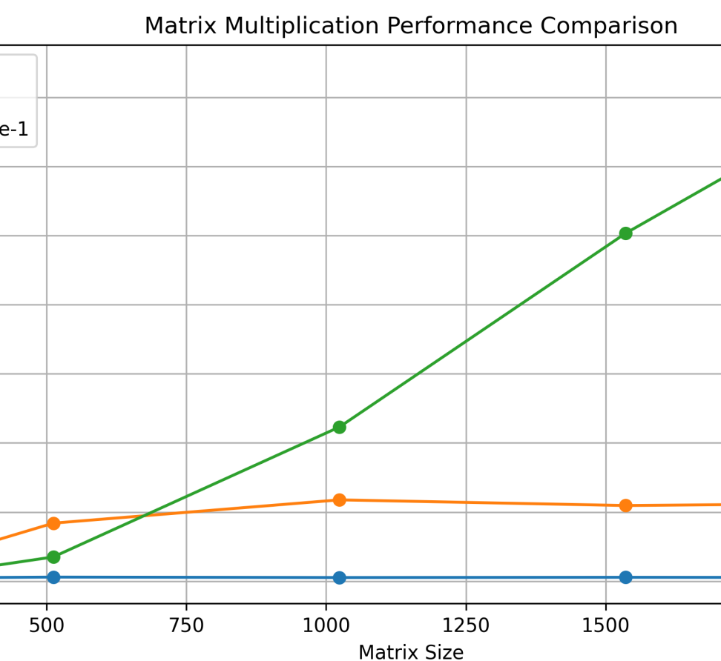
Matrix Multiplication Performance
Hardware | Execution time | Performance
Intel Xeon CPU | 16.136 ms | 133.08 GFLOPS
NVIDIA T4 GPU | 0.730 ms | 2,941.3 GFLOPS
Google TPU v5e | 0.385 ms | 5,577.9 GFLOPS

Slide 8
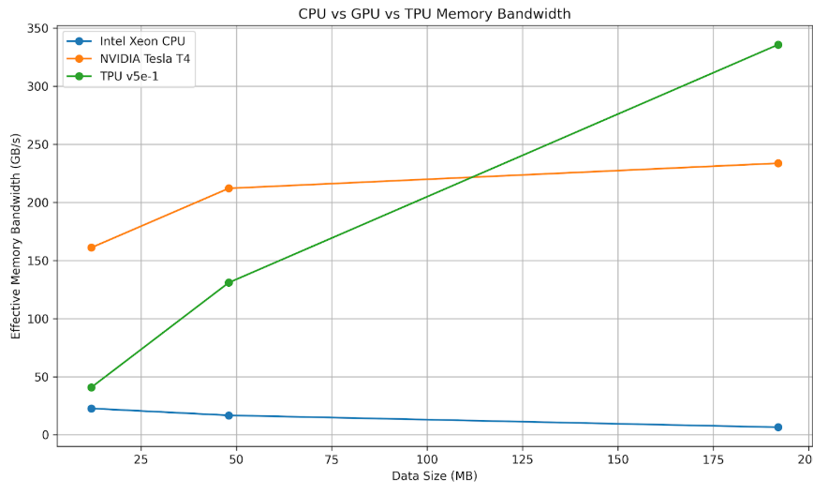
Memory Bandwidth Comparison
Hardware | Bandwidth
Intel Xeon CPU | 6.47 GB/s
NVIDIA Tesla T4 GPU | 233.66 GB/s
Google TPU v5e | 335.73
Key Observations
TPU recorded the highest measured memory bandwidth.
GPU also achieved substantially higher bandwidth than CPU.

Slide 9
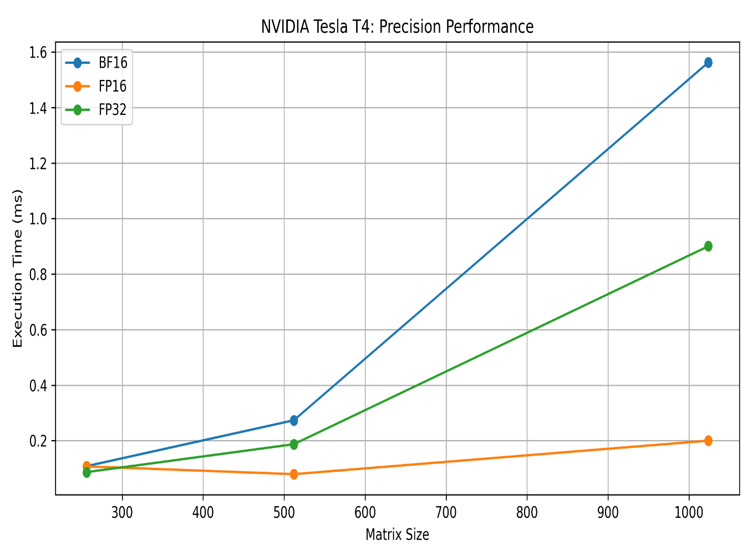
Impact of Numerical Precision
NVIDIA Tesla T4 — 1024 × 1024 Matrix
Precision | Execution time
FP32 | 0.854 ms
FP16 | 0.1666 ms
BF16 | 1.492 ms

Slide 10
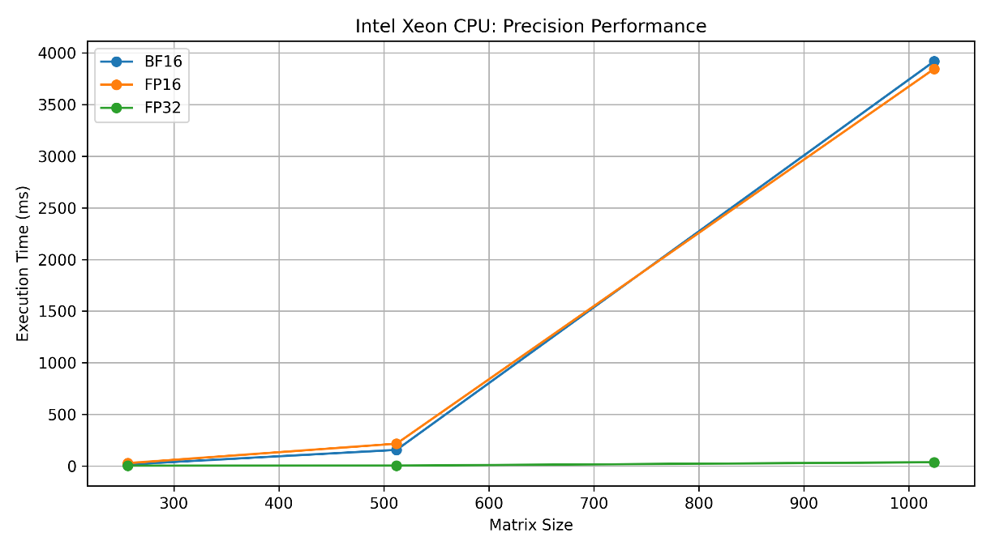
Impact of Numerical Precision: FP32, FP16 and BF16
Intel Xeon CPU — 1024 × 1024 Matrix
Precision | Execution time
FP32 | 36.998 ms
FP16 | 3844.8 ms
BF16 | 3917.9 ms

Slide 11
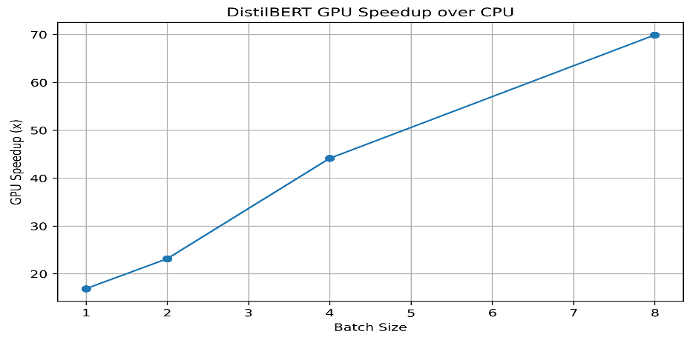
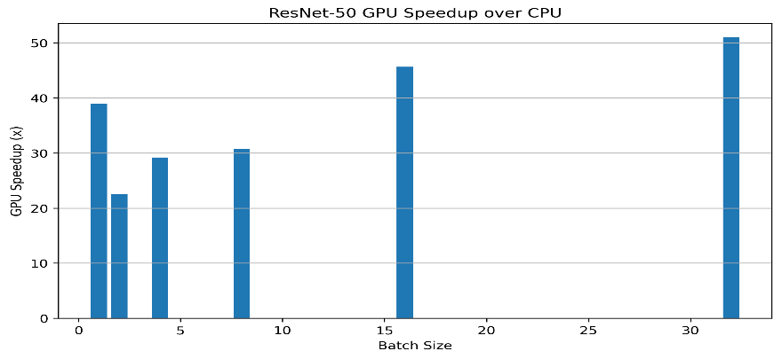
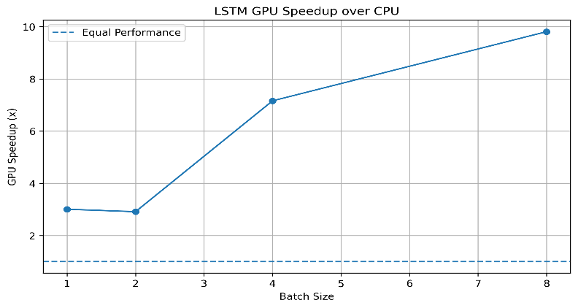
AI Inference Workload Evaluation
ResNet-50 (CNN)
Used for image classification.
Evaluated on CPU and NVIDIA T4 GPU.
Tested with different batch sizes.
DistilBERT (Transformer)
Used for natural language processing.
Model size: 66.36 million parameters.
Evaluated on CPU and GPU
LSTM (Sequence Model)
Used for sequential data processing.
Model size: 232,714 parameters.
Evaluated on CPU and GPU.

Slide 12
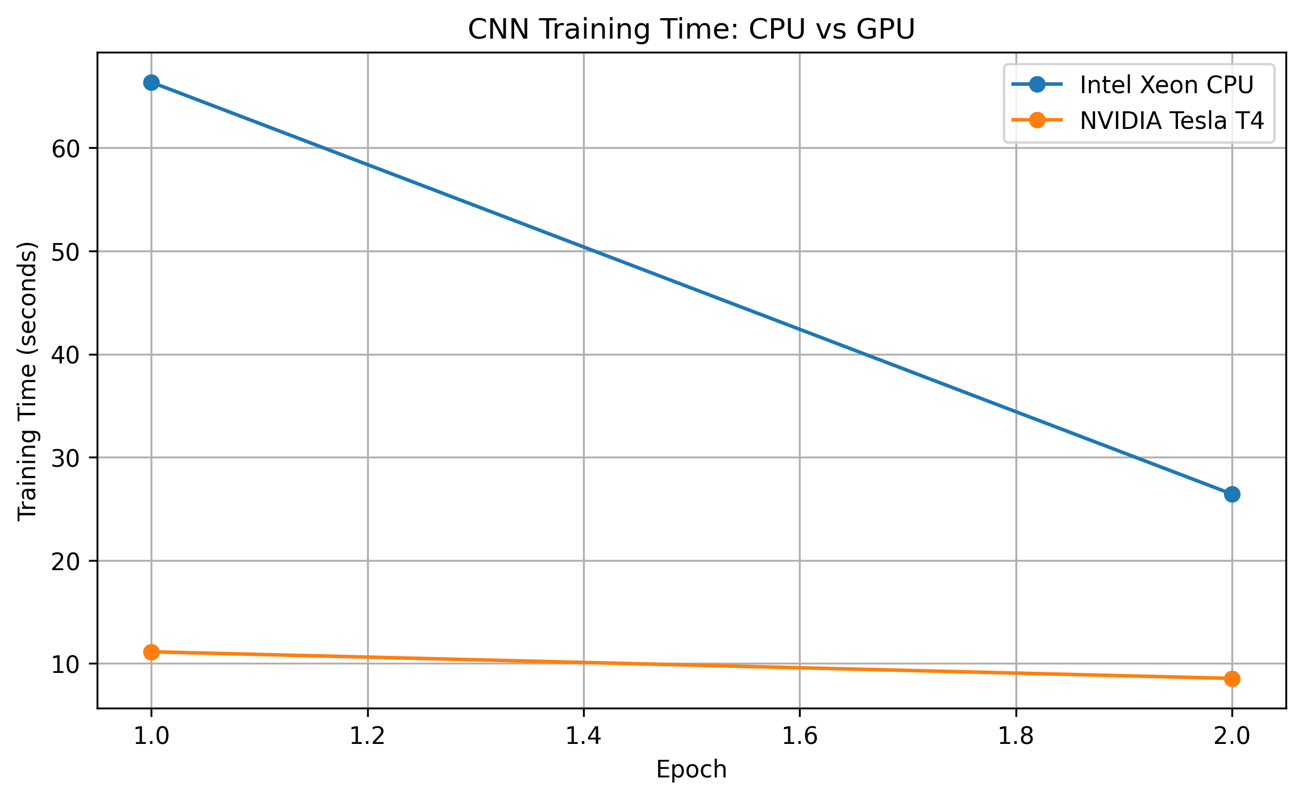
CNN Training Performance
FashionMNIST CNN — 2 Epochs, Batch Size 128
Metric | CPU | NVIDIA T4
Training time | 100.371 s | 21.586 s
Test accuracy | 86.97% | 87.41%
Peak GPU memory | — | 478 MB

Slide 13
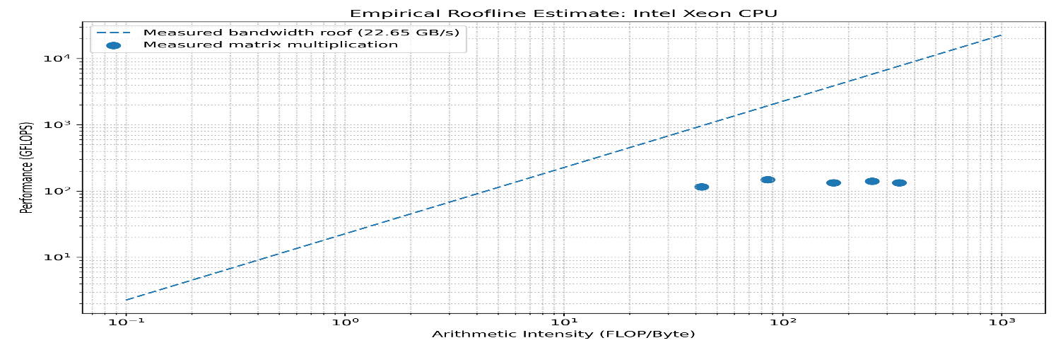
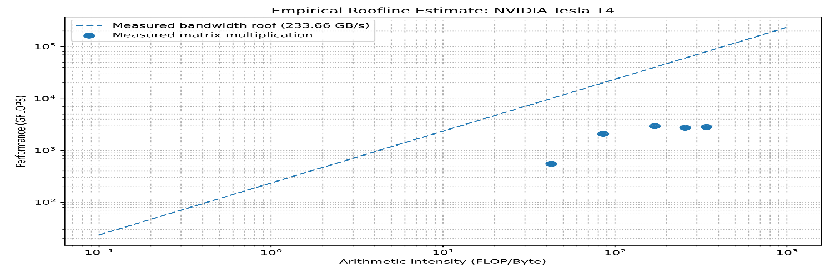
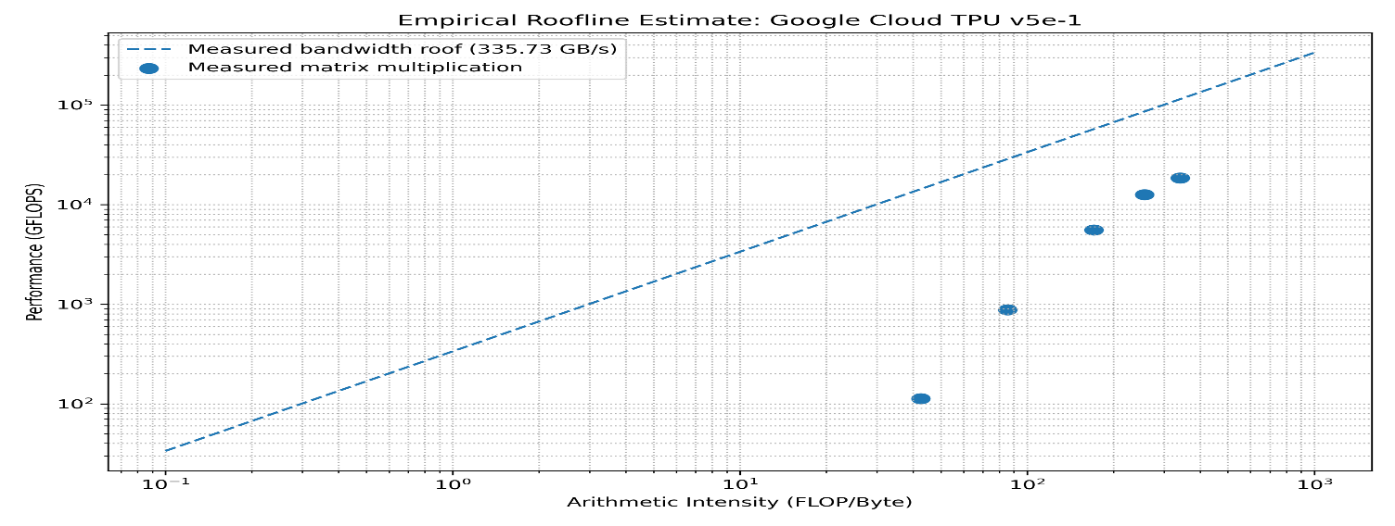
Performance Analysis Models
Performance Analysis: Roofline Model & Amdahl's Law
1. Roofline Model
Analyzes the relationship between computational performance and memory bandwidth.
Helps identify whether a workload is compute-bound or memory-bound.
Separate Roofline analysis was prepared for CPU, GPU and TPU.

Slide 14
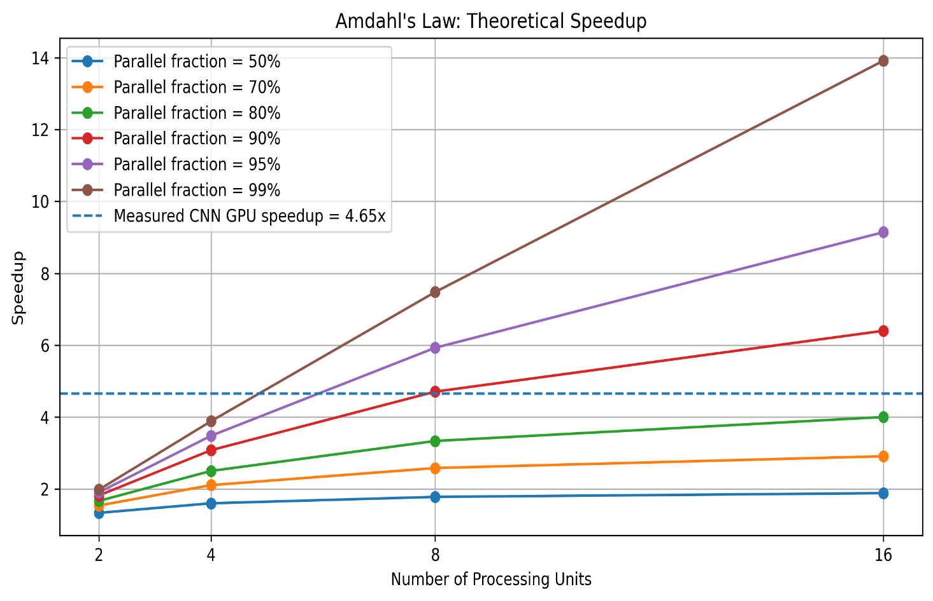
Performance Analysis: Roofline Model & Amdahl's Law
Amdahl's Law
Explains the theoretical speedup achievable through parallel processing.
Used a parallel fraction of 50% and two processors in the example.
Calculated theoretical speedup: 1.333×.

Slide 15
Key Findings and Discussion
Major Findings
TPU achieved the highest measured matrix multiplication performance at 1024 × 1024.
GPU provided significantly higher matrix performance than CPU.
TPU showed the highest measured memory bandwidth.
FP16 was fastest on the NVIDIA T4 among the tested precision formats.
Reduced precision did not improve performance in the tested CPU software environment.
GPU completed CNN training approximately 4.65× faster than CPU.
Different AI workloads showed different computational requirements.
Overall Discussion
Hardware architecture and numerical precision both influence AI inference performance.
The best choice depends on workload characteristics, software support and accuracy requirements.

Slide 16
Limitations
NPU hardware was not available for experimental evaluation.
TPU training and transfer measurements were limited by the available environment.
Full CPU instruction count and CPI profiling could not be obtained in Google Colab.
INT8 benchmarking was not completed.
Experiments were conducted in a cloud-based environment with limited hardware control.
Future Work
Evaluate AI inference on a physical NPU.
Perform additional TPU training and data transfer experiments.
Extend numerical precision testing to INT8.
Conduct detailed CPU hardware-counter profiling.
Evaluate more AI models and additional hardware platforms.

Slide 17
Conclusion & Thank You
Main Conclusions
GPU and TPU achieved higher matrix multiplication performance than CPU in the tested environment.
Numerical precision affected execution time and numerical accuracy.
The best hardware and precision format depend on the workload and software support.
Overall Conclusion
Efficient AI computing requires a balance between performance, numerical accuracy and hardware capabilities.
Thank You!
Questions & Answers

